Slide 1
How Do we classify Plants?

Slide 2
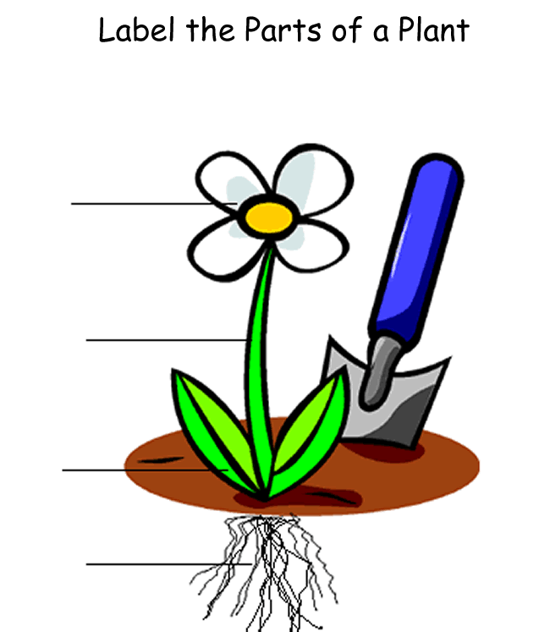
Flower
Leaves
Roots
Stem

Slide 3
Questions to ask when classifying a plant:
How plants transport water and nutrients
How plants make new plants (reproduce)

Slide 4
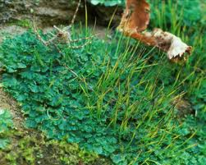
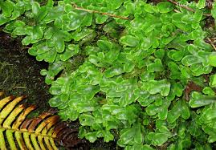
How Plants transport Water and nutrients:
Vascular plants – have tubelike structures that connect the leaves, stems, and roots and transport water
Examples: Trees, grass, dandelions
Nonvascular plants – do not have leaves, stems, and roots. So these plants carry water through cells that are next to each other
Examples: Mosses, Hornworts, and Liverwarts

Slide 5
How plants reproduce (make new plants)
Have flowers and make seeds These are called Flowering Plants.
Grow two cones (like pine cones). One makes pollen and the other makes seeds. These are called Conifers.
Do not make seeds, but form tiny cells that can grow into new plants. These are called spores and include Ferns and Mosses.

Slide 6
Turn to Page 17 in your textbook

Slide 7
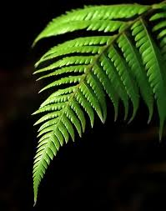
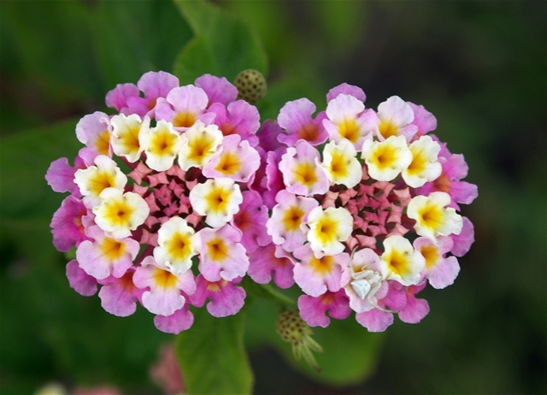
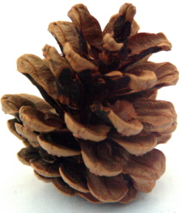
Flowering Plant
Ferns and Mosses
Conifer

