Slide 1
Where in the World are We??

Slide 3
What planet do we live on?
Earth

Slide 4
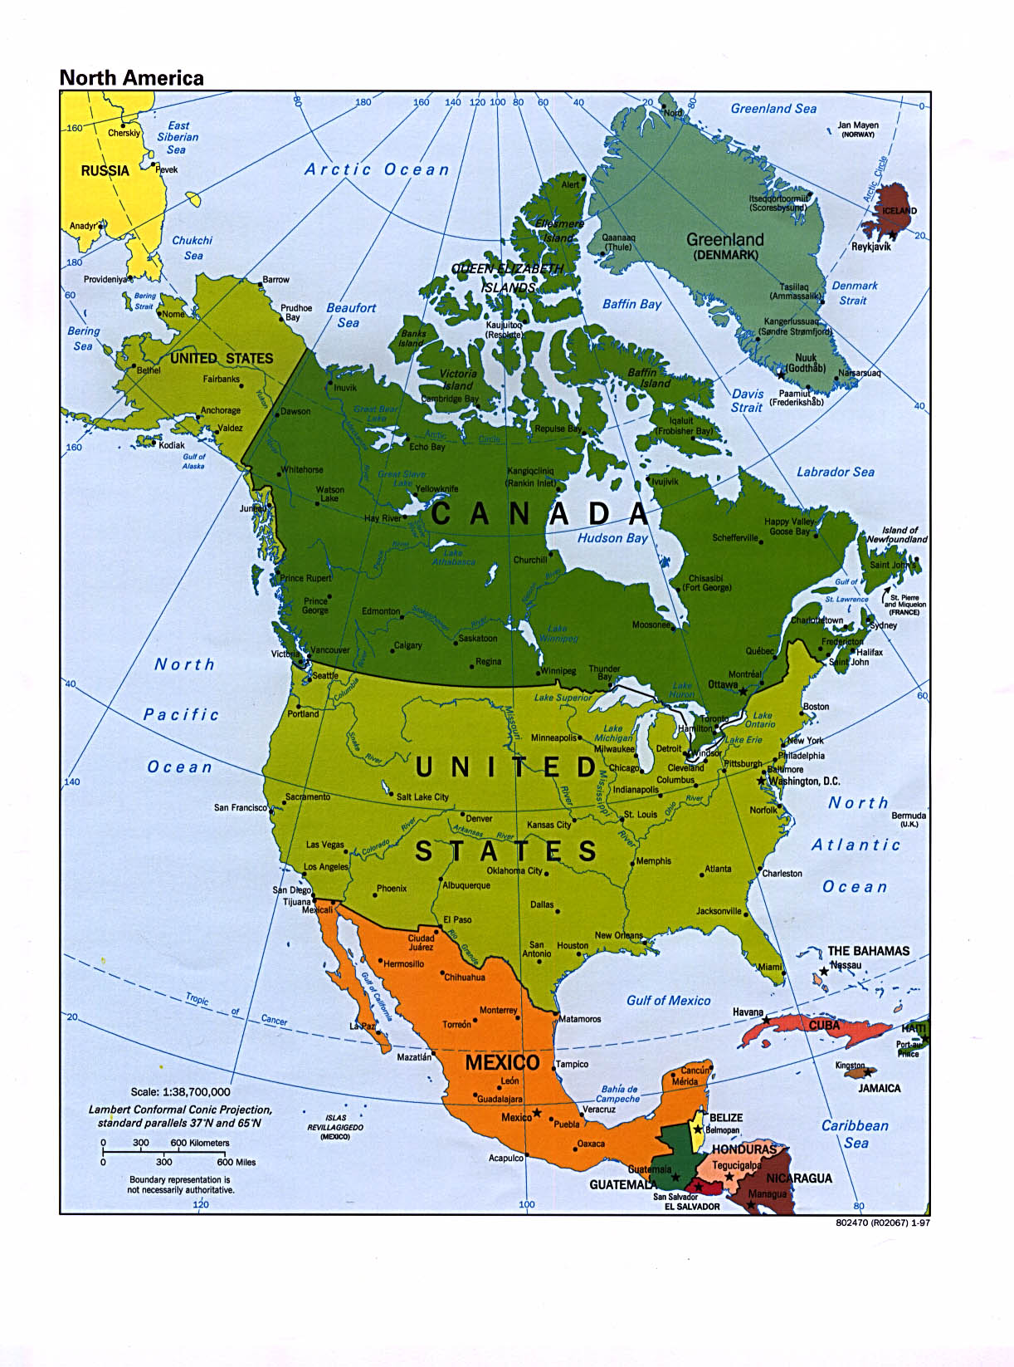
What continent do we live on?
North America

Slide 5
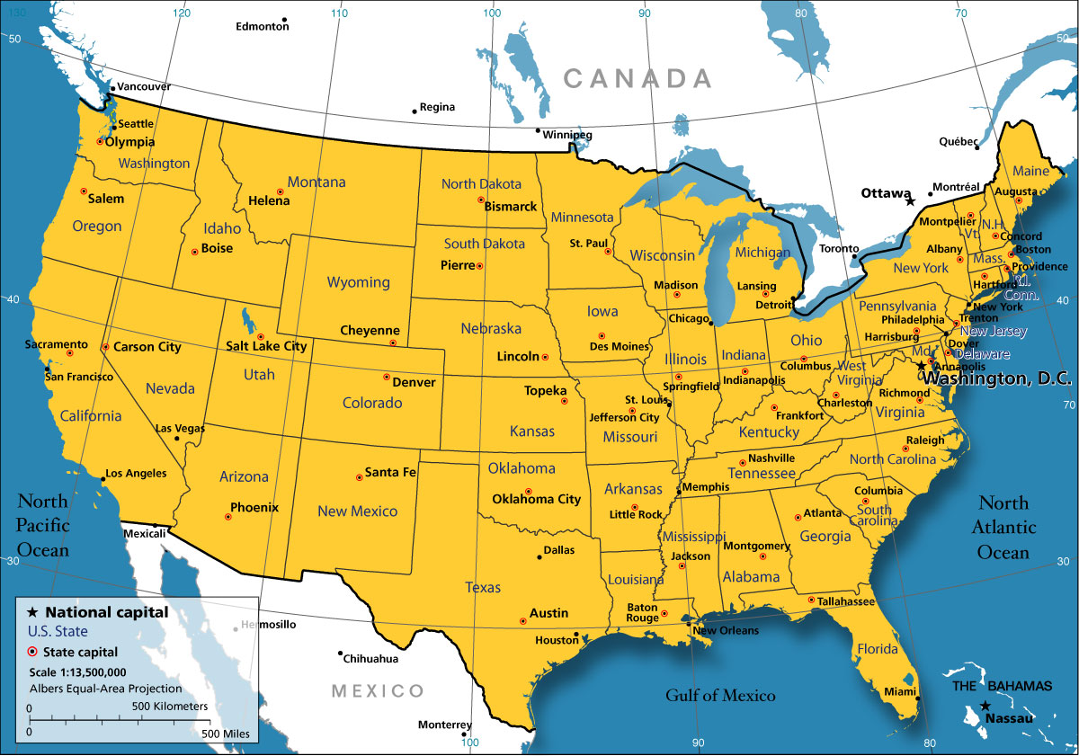
What country do we live in?
United States of America

Slide 6
What state do we live in?
Wisconsin

Slide 7
What county do we live in?
Lafayette County

Slide 8
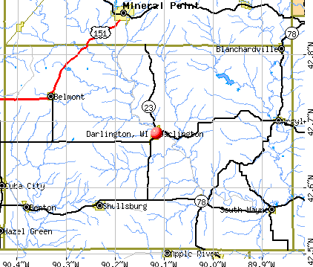
What town do we live in?
Darlington

Slide 9
What school do we go to?
DEMS: Darlington Elementary and Middle School
11630 Center Hill Road
Do Global Address
Worksheet.

Slide 10
Review
Planet
Continent
Country
State
County
Town

